Slide 1
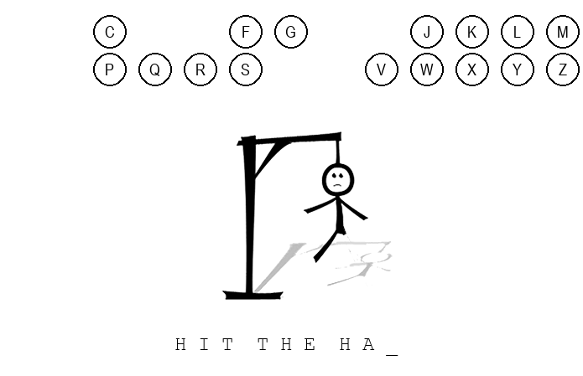
Hangman-2025
Sharpen Your Mind, One Letter at a Time.
Team member: Briohny Phengsy
Hangman-2025 is the modern adaptation of the classic childhood game Hangman. The goal is simple: guess the letters that form the hidden word. Each correct guess uncovers a new piece of the puzzle, bringing you closer to solving it. However beware, only five wrong guesses stand between you and the hangman’s fate.
https://github.com/ksu-is/Hangman-2025

Slide 2
Source code/tutorial
https://github.com/ksu-is/Hangman_
https://youtu.be/UEO1B_llDnc?si=JAu-q0Pbi-IGSLGF

Slide 3
Key Changes
Deleted duplicated code. The original repository I forked, called Hangman_, had 270 lines of code, and now Hangman-2025 has 189.
Inserted a welcome message.
Fixed the function that makes the letter buttons disappear.
Made the “loser” screen red instead of green.
Added 40 new words and phrases.

